Slide 1
IMPLEMENTATION AND MAINTENANCE OF THE WATER RECONCILIATION STRATEGY FOR RICHARDS BAY AND SURROUNDING TOWNS
Strategy Steering Committee Meeting
(SSC) 5
Wednesday, 7 April 2021

Slide 2
IMPLEMENTATION AND MAINTENANCE OF THE WATER RECONCILIATION STRATEGY FOR RICHARDS BAY AND SURROUNDING TOWNS
Strategy Steering Committee Meeting
(SSC) 5
Item 2: Attendance and Apologies

Slide 3
IMPLEMENTATION AND MAINTENANCE OF THE WATER RECONCILIATION STRATEGY FOR RICHARDS BAY AND SURROUNDING TOWNS
Strategy Steering Committee Meeting
(SSC) 5
Item 3: Acceptance of Agenda

Slide 4
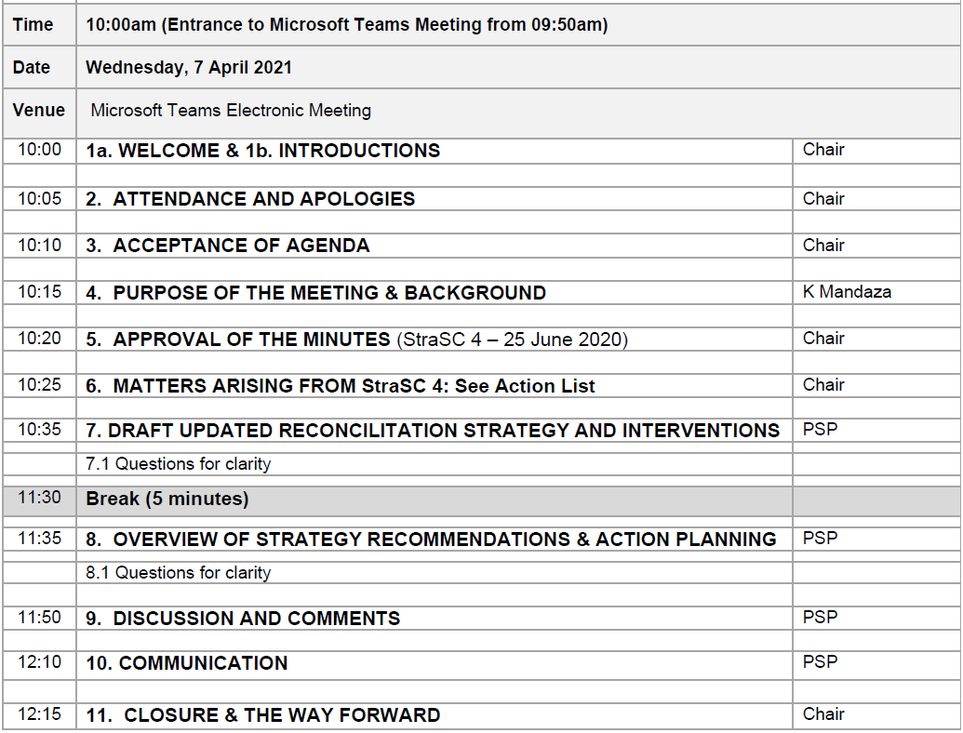
Agenda

Slide 5
IMPLEMENTATION AND MAINTENANCE OF THE WATER RECONCILIATION STRATEGY FOR RICHARDS BAY AND SURROUNDING TOWNS
Strategy Steering Committee Meeting
(SSC) 5
Item 4: Purpose of Meeting

Slide 6
Purpose
FINAL STRA SC MEETING OF THIS PHASE OF STUDY
      Continuation Phase being Initiated
PRESENT DRAFT STRATEGY
PRESENT AND GAIN APPROVAL FOR INTERVENTION ACTION PLAN AND RESPONSIBILITIES

Slide 7
IMPLEMENTATION AND MAINTENANCE OF THE WATER RECONCILIATION STRATEGY FOR RICHARDS BAY AND SURROUNDING TOWNS
Strategy Steering Committee Meeting
(SSC) 5
Item 5: Minutes and Matters Arising

Slide 8
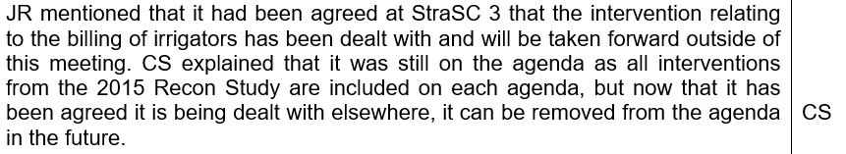
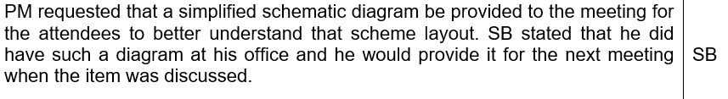
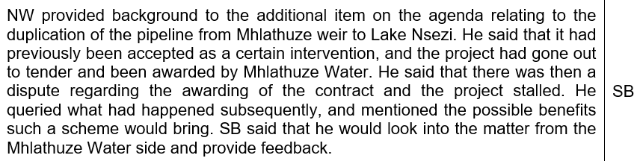
ACTION LIST

Slide 9


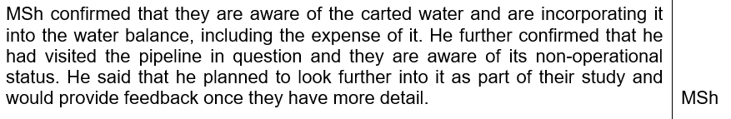

ACTION LIST

Slide 10
IMPLEMENTATION AND MAINTENANCE OF THE WATER RECONCILIATION STRATEGY FOR RICHARDS BAY AND SURROUNDING TOWNS
Strategy Steering Committee Meeting
(SSC) 5
Item 6: Draft Updated Recon Strategy

Slide 11
OVERVIEW: TOC
Exec Summary
      For document, “glossy” extended executive summary to be completed as separate deliverable
INTRODUCTION & CONTEXT
SUMMARY CHAPTERS ON INDIVIDUAL TASKS DETAILED IN STAND ALONE TECHNICAL REPORTS
        Demographics & water requirements
        WCWDM
        Water Resources Availability

Slide 12
OVERVIEW: TOC
CURRENT WATER BALANCES
AVAILABLE INTERVENTION OPTIONS
WATER BALANCES INCLUDING OPTIONS
PROPOSED ACTION PLAN
WAY FORWARD

Slide 13
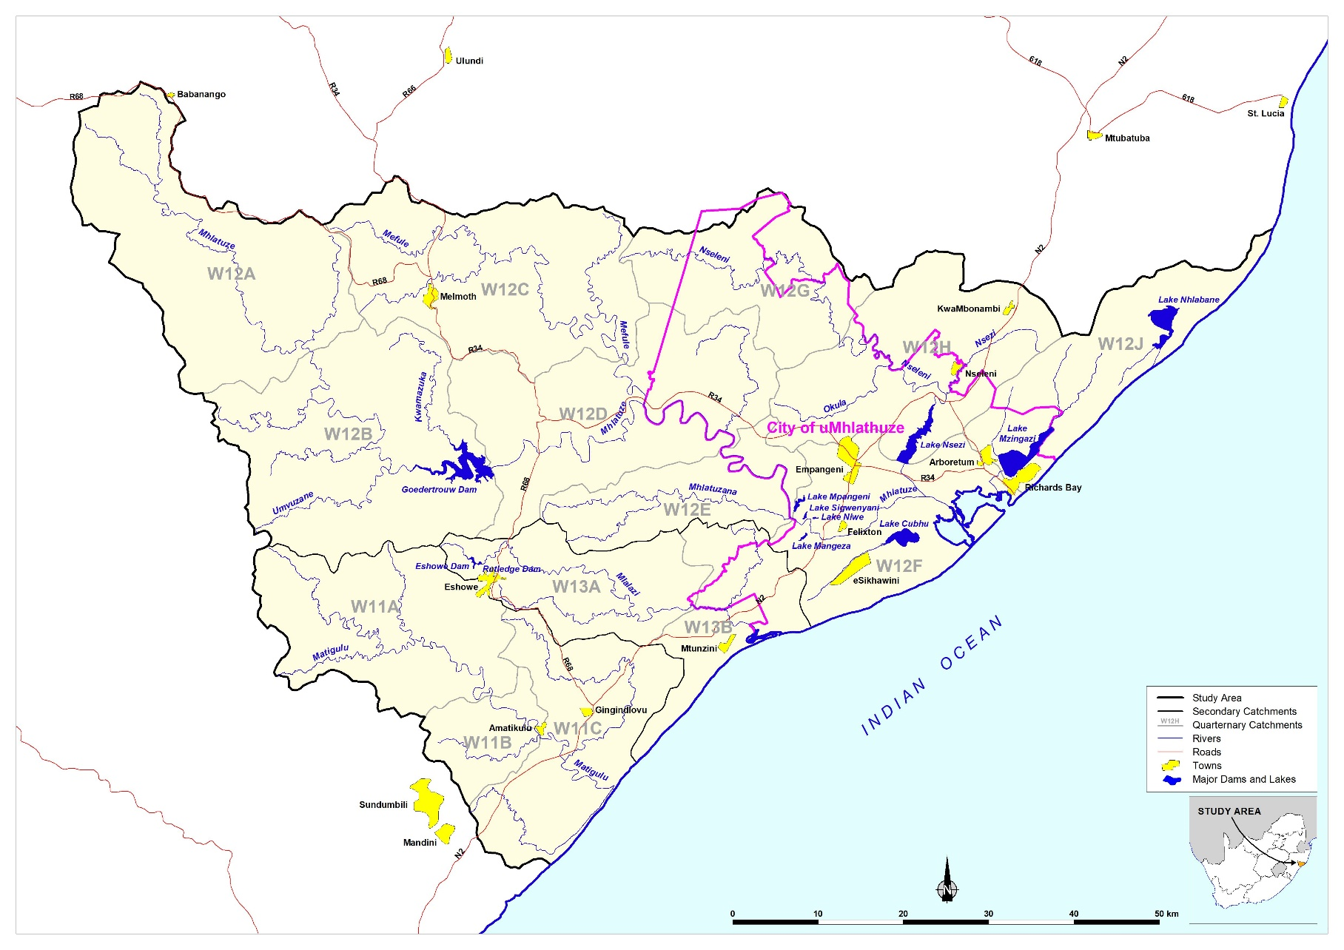
STUDY AREA

Slide 14
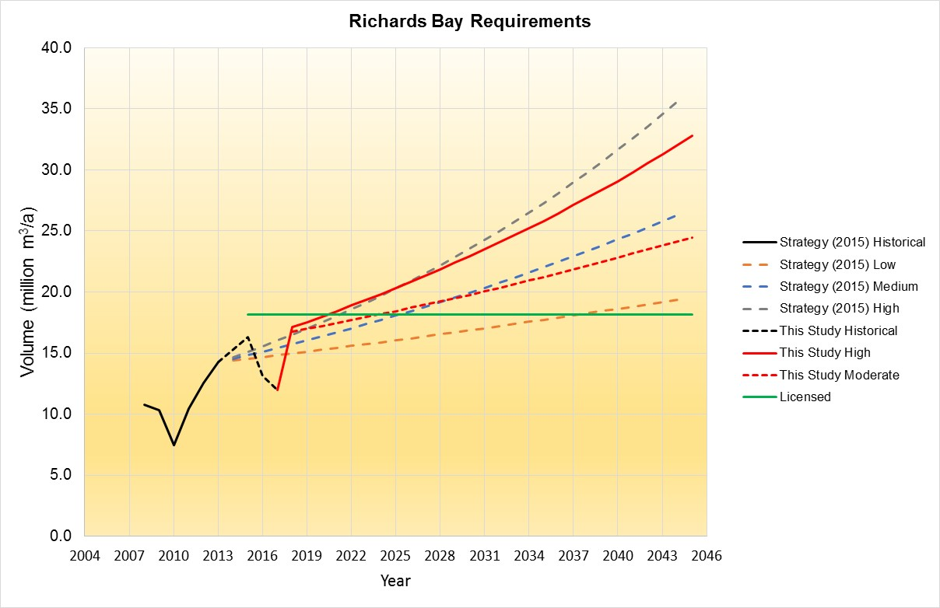
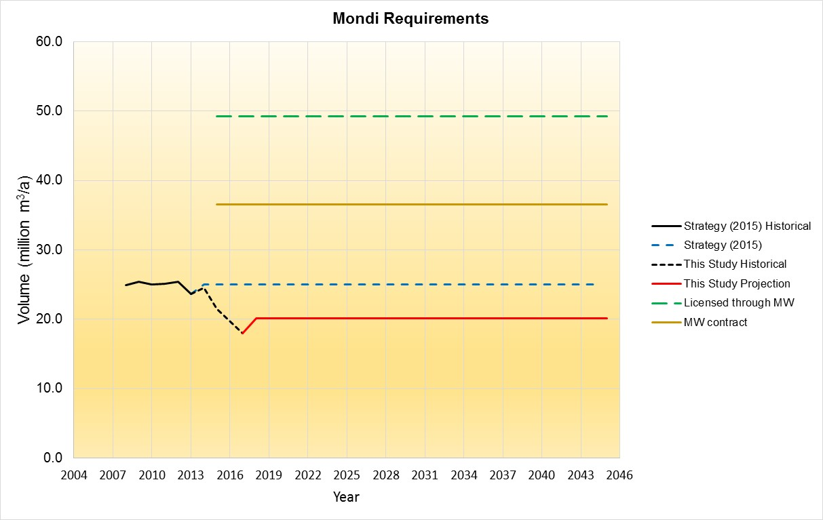
Water REQUIREMENTS

Slide 15
Water REQUIREMENTS

Slide 16
POSSIBLE INTERVENTION OPTIONS
REDUCE WATER USE
        WCWDM
        Remove alien vegetation
        Water Reuse

Slide 17
WCWDM
Indicator | Current Value | Realistic Target value 10% Reduction | Optimistic Target Value 20% Reduction
System Input volume (million m³/a) | 39,15 | 34.89 | 32.23
System Input volume (Mℓ / day) | 107,19 | 95.54 | 88.24
Billed Authorised Consumption (million m³/a) | 30,00 | 24.32 | 23.89
Unbilled Authorised Consumption (million m³/a) | 1,95 | 4.52 | 4.47
Water Losses (million m³/a) | 7,20 | 6.06 | 3.87
Non-revenue Water (million m³/a) | 9,15 | 10.57 | 8.34
% Non-revenue water | 43% | 30% | 26%
% Water Losses | 24% | 17% | 12%
Input Volume (litres / capita / day) | 277 | 246 | 228
Input Volume (m³ / household / month) | 35 | 31 | 29
Authorised Consumption (litres / capita / day) | 226 | 204 | 200
Authorised Consumption (m³ / household / month) | 29 | 26 | 26
CoMLM: +- 6 million m³ by 2025
Kcdm: +- 0.6 million m³ by 2025

Slide 18
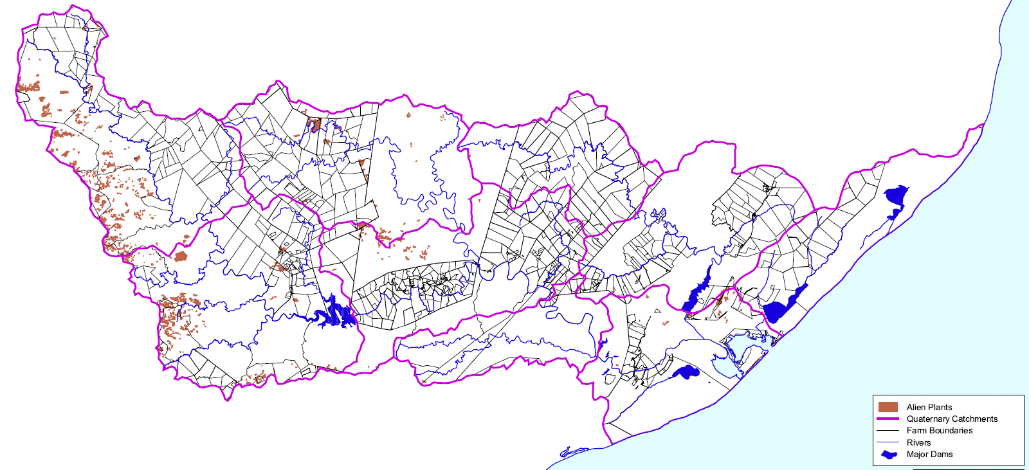
Remove alien vegetation

Slide 19
WATER REUSE
CoMLM DRIVEN INTERVENTION
ADVANTAGES
TARGET 30 ML/D (11 MILLION M³)
ONGOING INVESTIGATIONS OF PPP
Utilisation of a potential water source previously “lost” by being discharged into the sea at Alkantstrand;
Reduced demand on natural resources by industrial users;
Augmentation of the Municipality’s potable water resources through a source capable of producing a constant reliable output, influenced to a limited extent by drought cycles, as water demand is expected to slightly decrease when water restrictions are implemented.

Slide 20
POSSIBLE INTERVENTION OPTIONS
INCREASE WATER SUPPLY
        Efficient system operation
        Implement Operating Rules
        Transfers from neighbouring catchments
        New Dam Construction
        Existing Dam Raising

Slide 21
EFFICIENT SYSTEM OPERATION
REAL TIME OPERATIONS TO DETERMINE RELEASES FROM GOEDERTROUW DAM
MAXIMUM USE FROM LAKE MZINGAZI

Slide 22
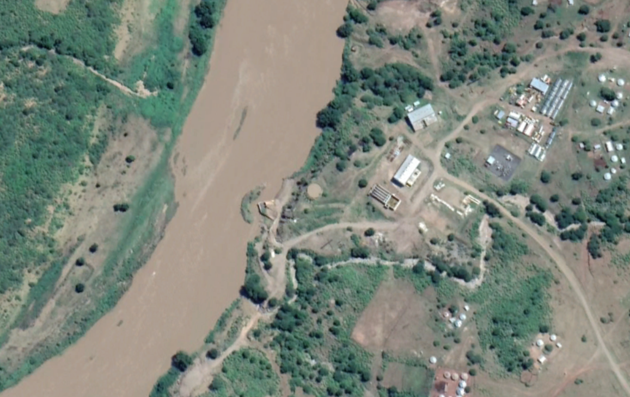
TRANSFERS FROM THUKELA
MAINTAIN EXISTING TRANSFER AND COMPLETE UPGRADE (1.2 M³/S TO 2.4 M³/S)

Slide 23
New dam construction
Nseleni river
55 million m³ storage
12 million m³/a yield

Slide 24
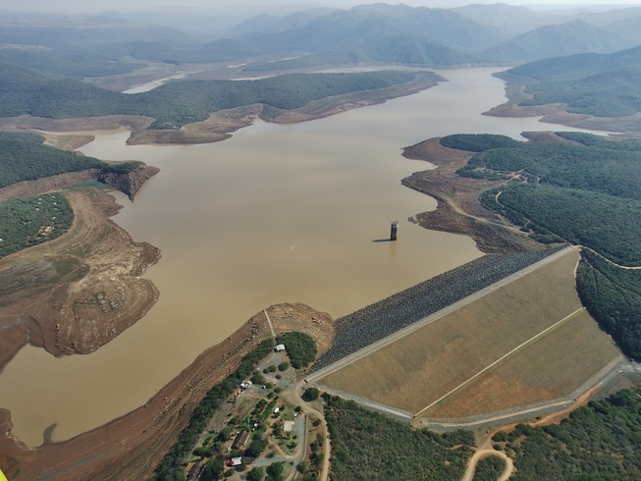
Existing dam raising
Goedertrouw dam
2.8m
12 million m³/a additional yield

Slide 25
PREVIOUS OPTIONS CONSIDERED
DESALINATION OF SEAWATER
LOWER THUKELA PIPELINE TRANSFER
UMFOLOZI OFF CHANNEL STORAGE DAM

Slide 26
WATER BALANCES

Slide 27
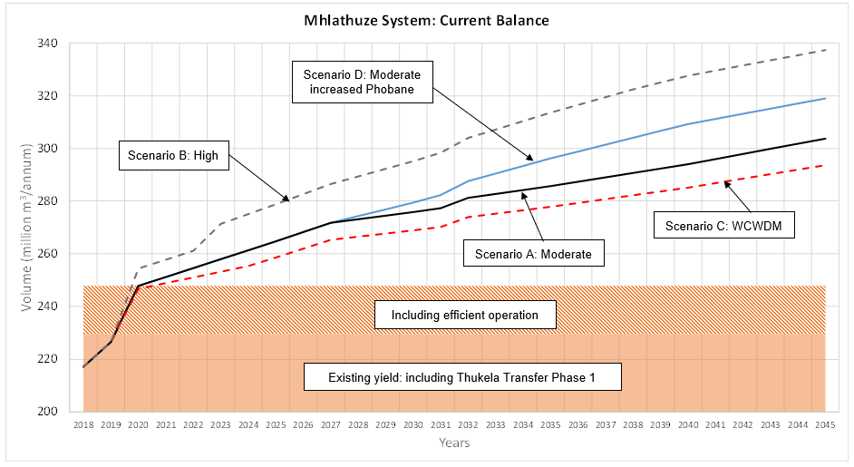
MHLATHUZE SYSTEM: CURRENT WATER BALANCE

Slide 28
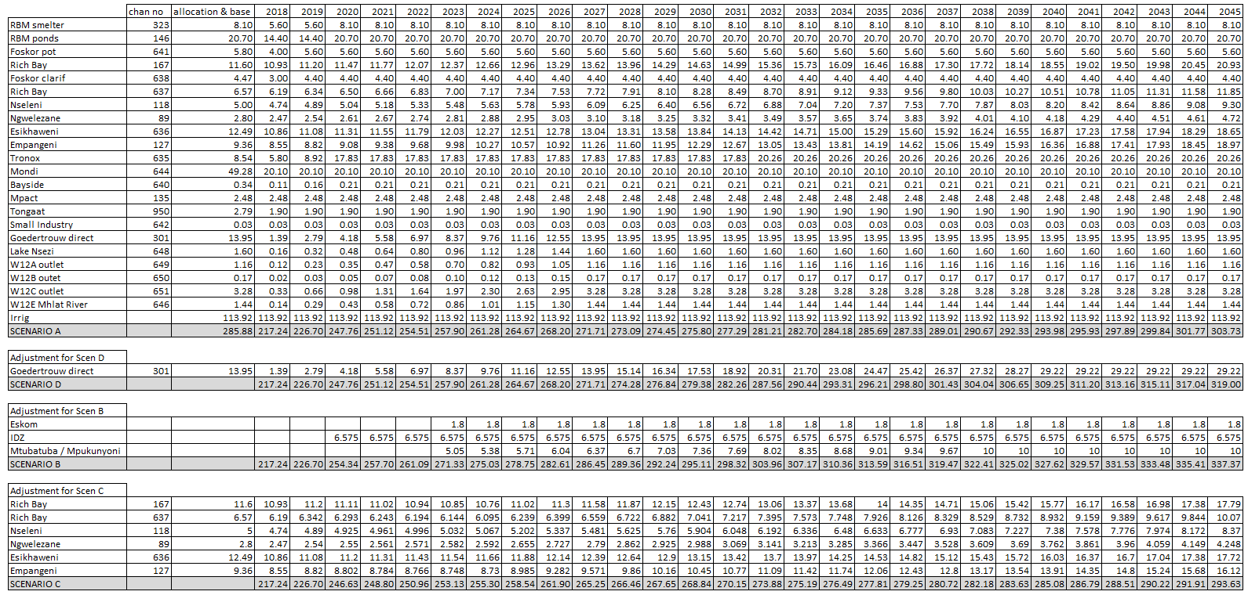
Water requirement projection scenarios

Slide 29
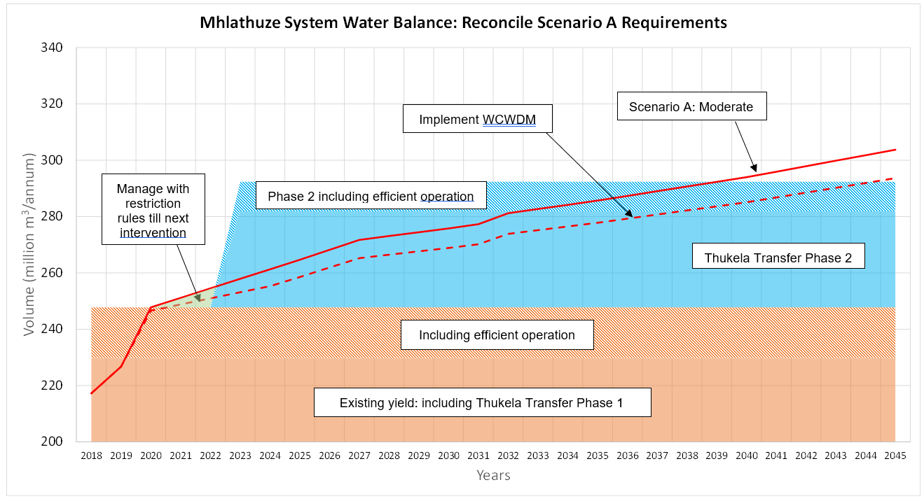
Reconciliation of scenario A
allocation

Slide 30
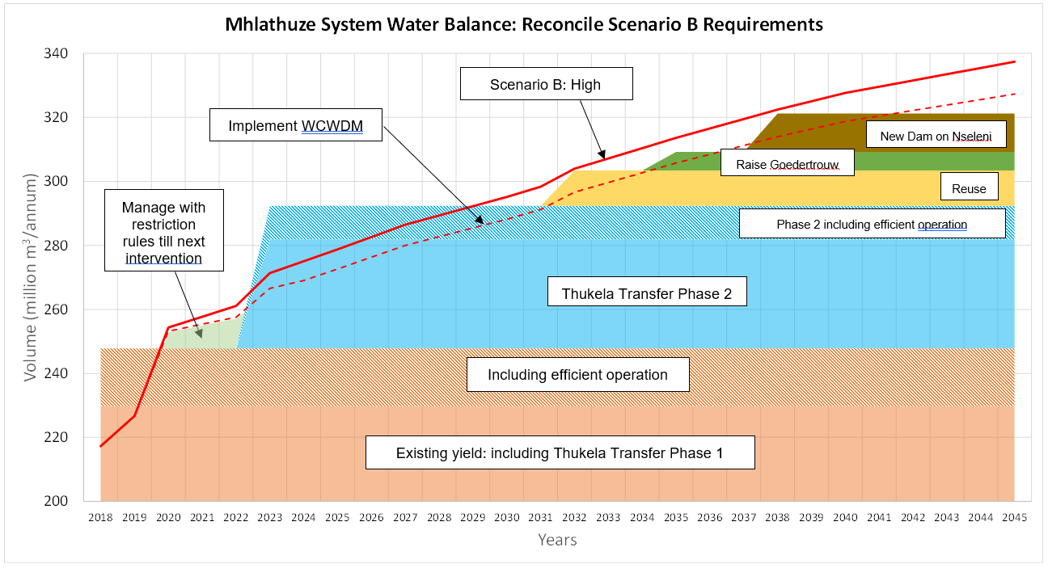
Reconciliation of scenario B
Umfolozi / Desalination
allocation

Slide 31
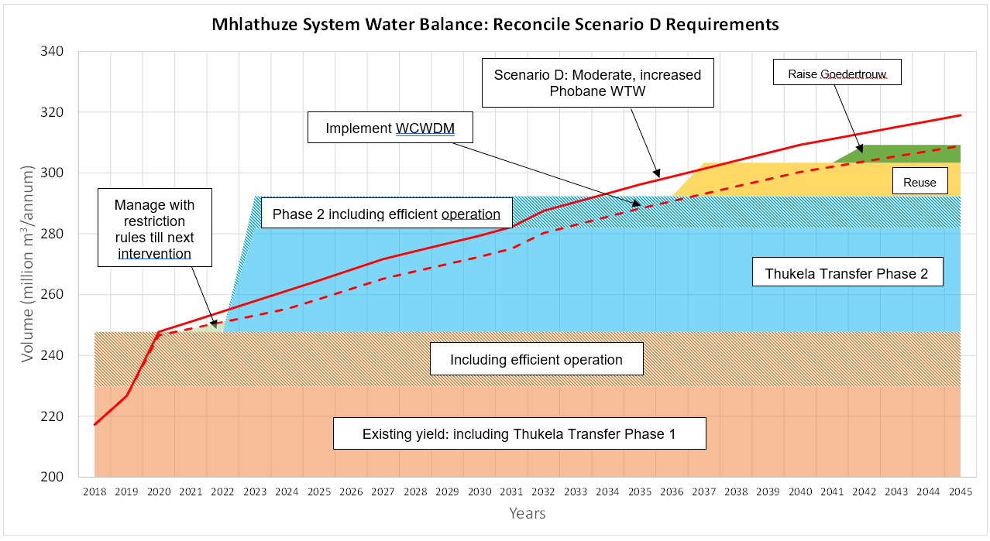
Reconciliation of scenario D
allocation

Slide 32
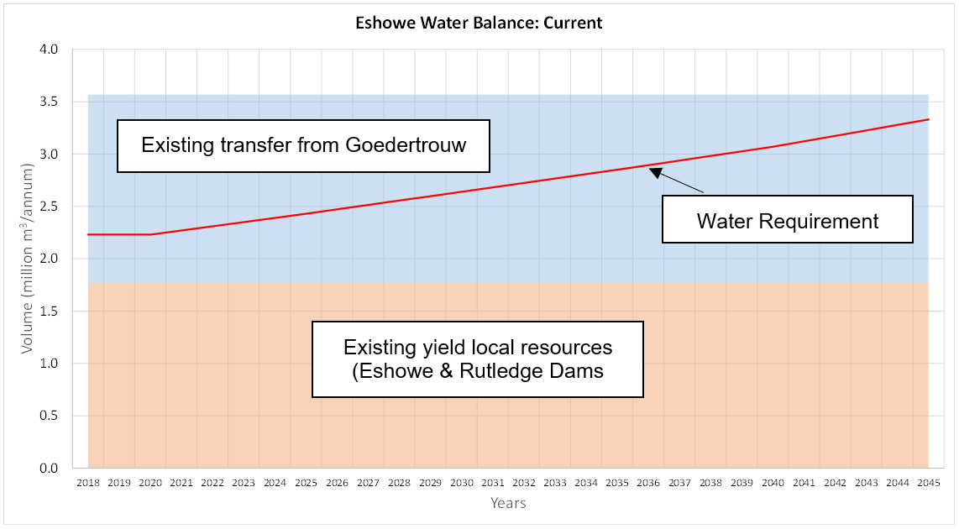
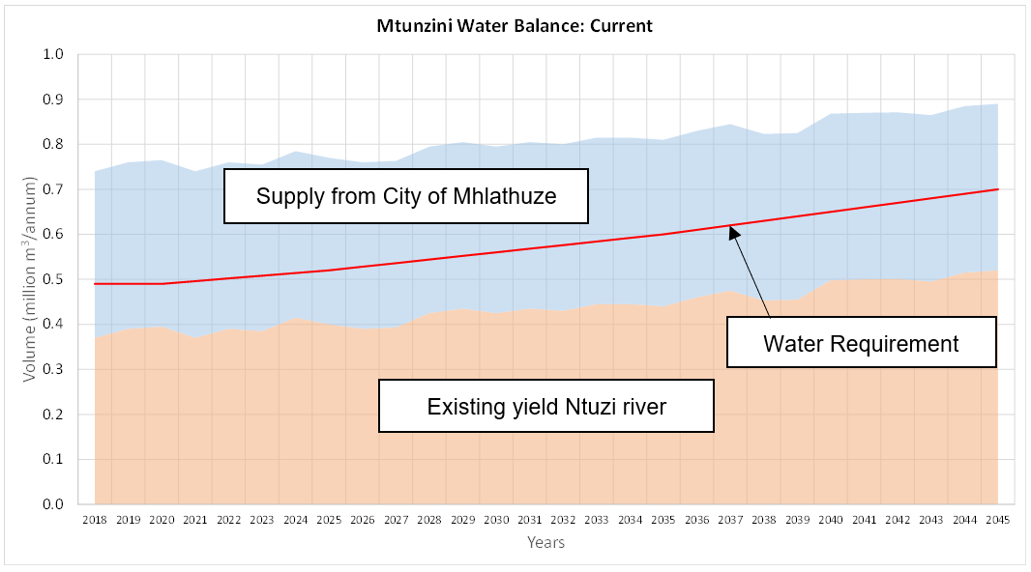

Slide 33
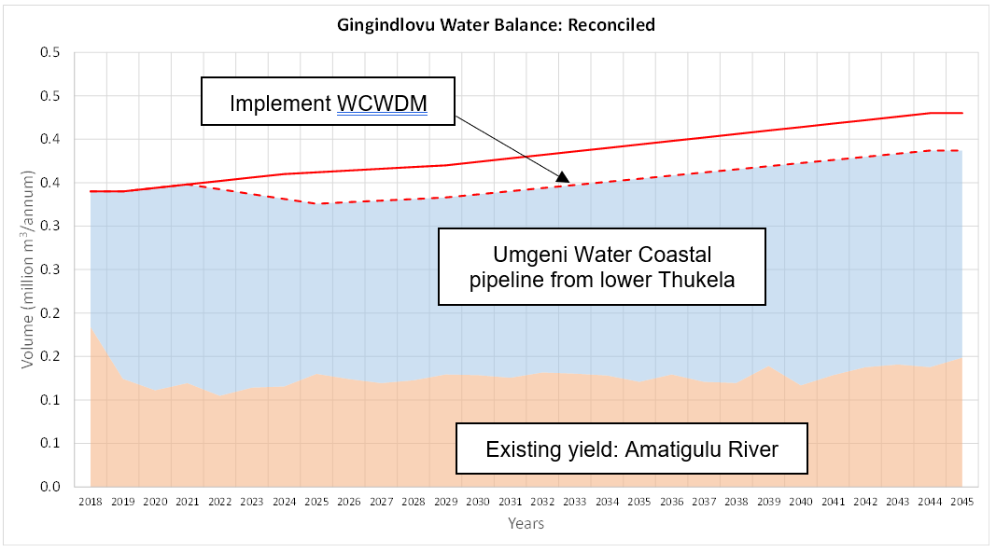
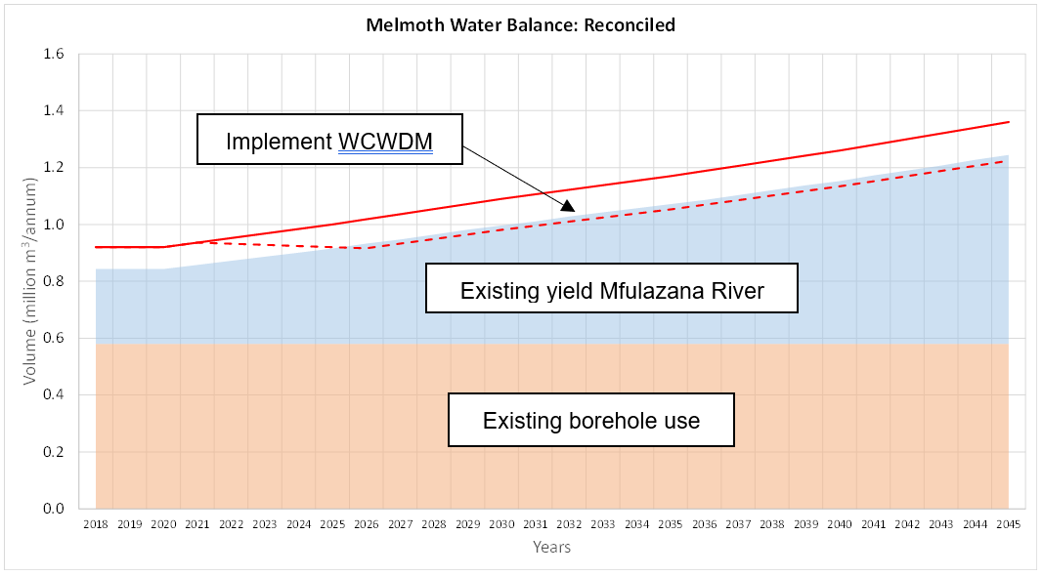

Slide 34
PROPOSED ACTION PLAN
INSTITUTIONAL RESPONSIBILITY
        DWS
        Municipalities
        Mhlathuze Water
TIME FRAMES

Slide 35
Intervention | Primary Responsibility | Comments | Target Date (priority)
WCWDM | Local Municipalities: City of Mhlathuze LM, KCDM, | CoMLM to continue with WCWDM activities KCDM to continue with existing WCWDM programme | High priority, implementation to continue/start immediately CoM: 10% savings, reduction in growth by 2025 (6.3 million m³) KCDM: 15% savings, reduction in growth by 2025 (0.6 million m³)
Maintain existing Thukela Transfer scheme | MW | Maintain installed capacity | Immediate and ongoing (34 million m³/annum)

Slide 36
Intervention | Primary Responsibility | Comments | Target Date (priority)
Complete Thukela Transfer upgrade from Middeldrift | DWS: RO NWRIB MW | The scheme was originally initiated as an emergency scheme. The initial urgency to implement should be maintained | High priority (December 2023) (34 million m³/annum)
Water Reuse | CoM LM | This intervention has been started. | Medium priority level (2032) (11 million m³/annum)
Interim Restriction Rule to Benefit Priority (Primary) Users | DWS: Directorate Water Resources Planning Systems | This study is underway | Immediate and ongoing
Efficient system operation | DWS RO | The existing system should not be allowed to fail, and should be expanded to additional key flow monitoring points throughout the catchments. It is specifically important to improve the flow monitoring in the tributary catchments upstream of the Mhlathuze weir in order to forewarn of water coming | Immediate and ongoing

Slide 37
Intervention | Primary Responsibility | Comments | Target Date (priority)
Existing Dam Raising | DWS: OA |  | Low priority (2035) (5.8 million m³/annum)
New Dam Construction | MW | Tendering to be undertaken by implementing agent, Construction to be outsourced. | Low priority (dam construction) (2038) Medium priority (feasibility study) (12 million m³/annum)
Lower Thukela Transfer to KCDM | Umgeni Water | This study has been initiated and communication with the study team should be ongoing | High priority
Remove alien vegetation | Department of Environmental Affairs, Mhlathuze CMF | Focus on areas upstream of Dams and Lakes | Immediate and ongoing
Groundwater | Municipalities | Promote development of GW resources for local WSSs | As and when required

Slide 38
WAY FORWARD
Water requirement projections and monitoring
Actual use: irrigation sector
Strasc coordination & implementation tracking

Slide 39
IMPLEMENTATION AND MAINTENANCE OF THE WATER RECONCILIATION STRATEGY FOR RICHARDS BAY AND SURROUNDING TOWNS
Strategy Steering Committee Meeting
(SSC) 5
Item 9: Discussion
Item 10: Communication
Item 11: Closure

